Slide 1

Making Sense of Gene Lists using MGI
Short Course Bioinformatics Workshops
2014

Slide 2
Gene Lists
Differentially Expressed Genes (DEGS) from RNA Seq Analysis
Genes in regions associated with complex trait mapping
Genes identified from exome analysis
Gene List Analyses
What are the functions, phenotypes, and disease associations for all of the genes in a list?
Is there a statistically significant functional of phenotypic “theme” in a gene list?
Are there mouse models available?

Slide 3

Bioinformatics Tools for Gene List Annotation and Analysis in Mouse
Batch Query Tool
http://www.informatics.jax.org/batch
Mouse Mine
www.mousemine.org

Slide 4
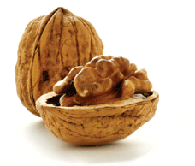
Batch Query in a Nutshell
Batch Query – Annotate a list of genes
Upload a list of symbols or other acceptable identifiers
Generate the annotations you are interested in
Download the results
Batch Query does not provide gene list analysis tools such as gene set enrichment
Example gene lists are available on DropBox site
https://www.dropbox.com/sh/seqishl631f363x/AADoBskzYjPt_iJI21dxJqV8a

Slide 5
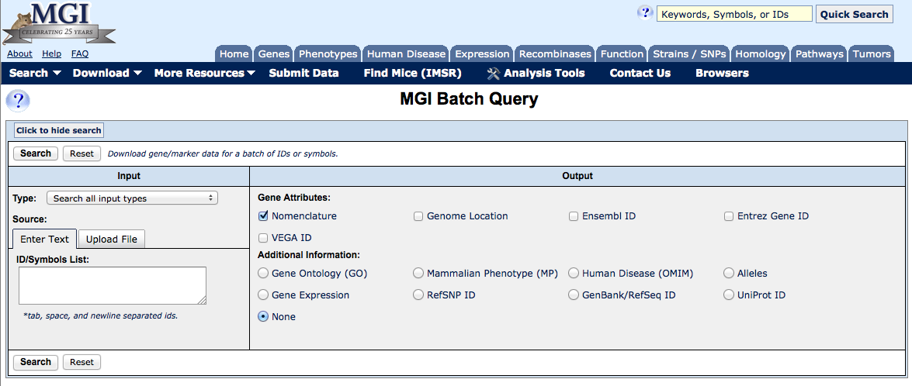
Batch Query
http://www.informatics.jax.org/batch
Gene lists available from DropBox site

Slide 6
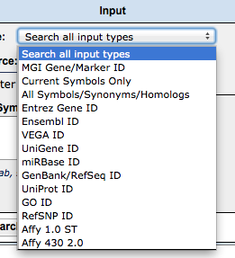
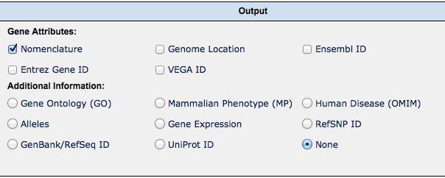
Input can be gene symbols or other identifiers.
Cut and paste a list or upload from a file.
Output can be genome location, gene function, disease associations, etc.

Slide 7
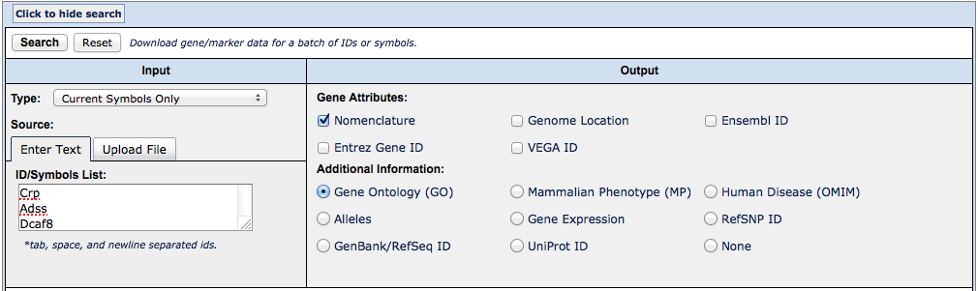
4. Click
2. Select input type
3. Select output options
1. Paste gene list

Slide 8
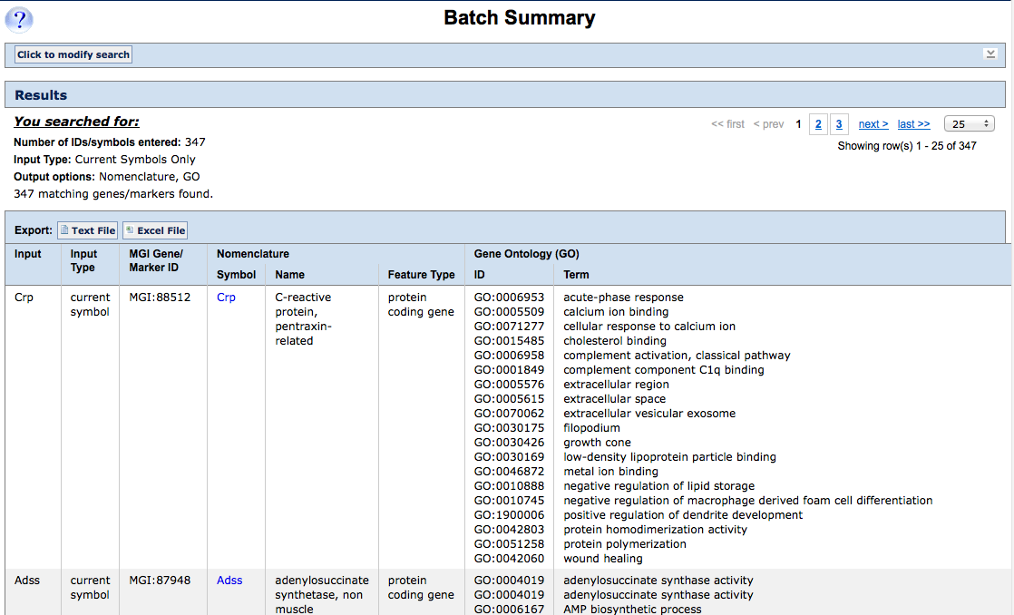
1. Download options
Gene Ontology annotations for input list of genes.

Slide 9
Modify search to select a new output type
1. Click

Slide 10
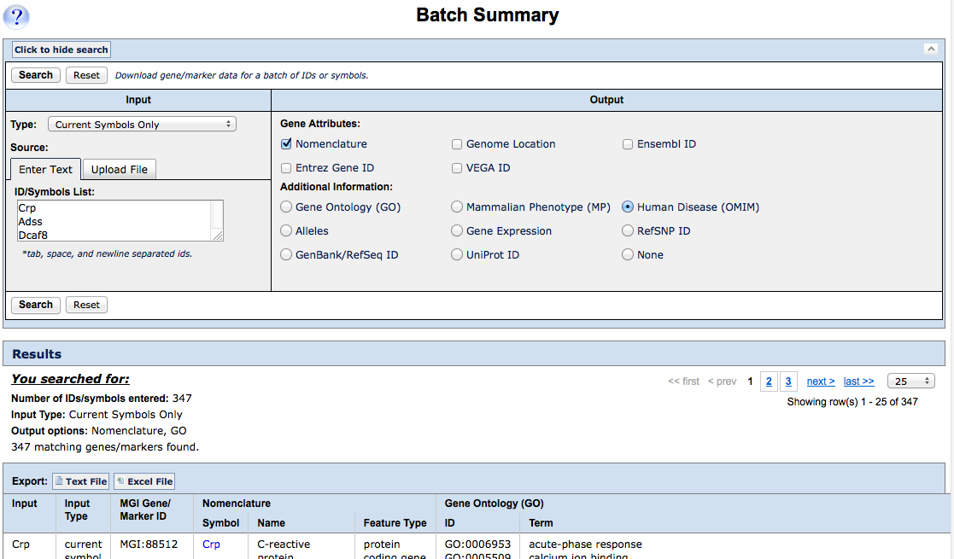
1. Click
Input remains the same.
Select new output option.

Slide 11
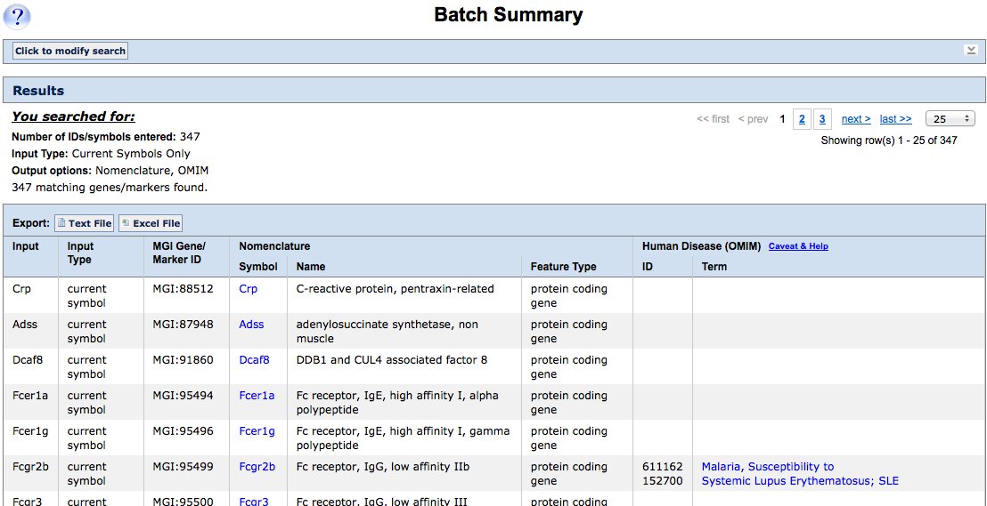
1. Download options
OMIM annotations for orthologous human genes.

Slide 12
MouseMine in a Nutshell
Mouse Mine
Retrieve a list of genes in a region
Upload a list of genes
Generate annotations for a gene list
One click access to orthologs in other model organism “mines”
MouseMine provides widgets for gene set enrichment and list comparison functions
Save gene lists
Create templated searches you can return to again and again

Slide 13
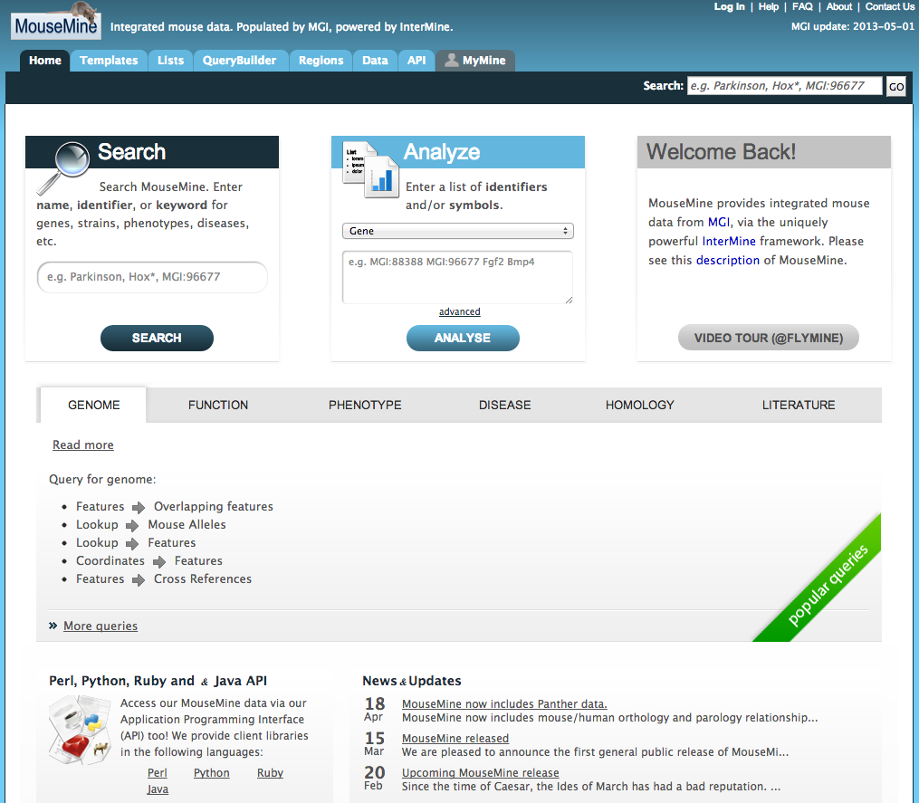
MouseMine@MGI
www.mousemine.org

Slide 14
MouseMine Demo
Search for genes in a genomic region
Save the list of genes (gene list 1)
Review the annotations for the genes
Find all genes associated with lung development
Save the list of genes (gene list 2)
Find the subset of genes in gene list 1 that are annotated to “lung development”
Save the intersected gene list (gene list 3)

Slide 15
Find all genes in a region
1. Click

Slide 16
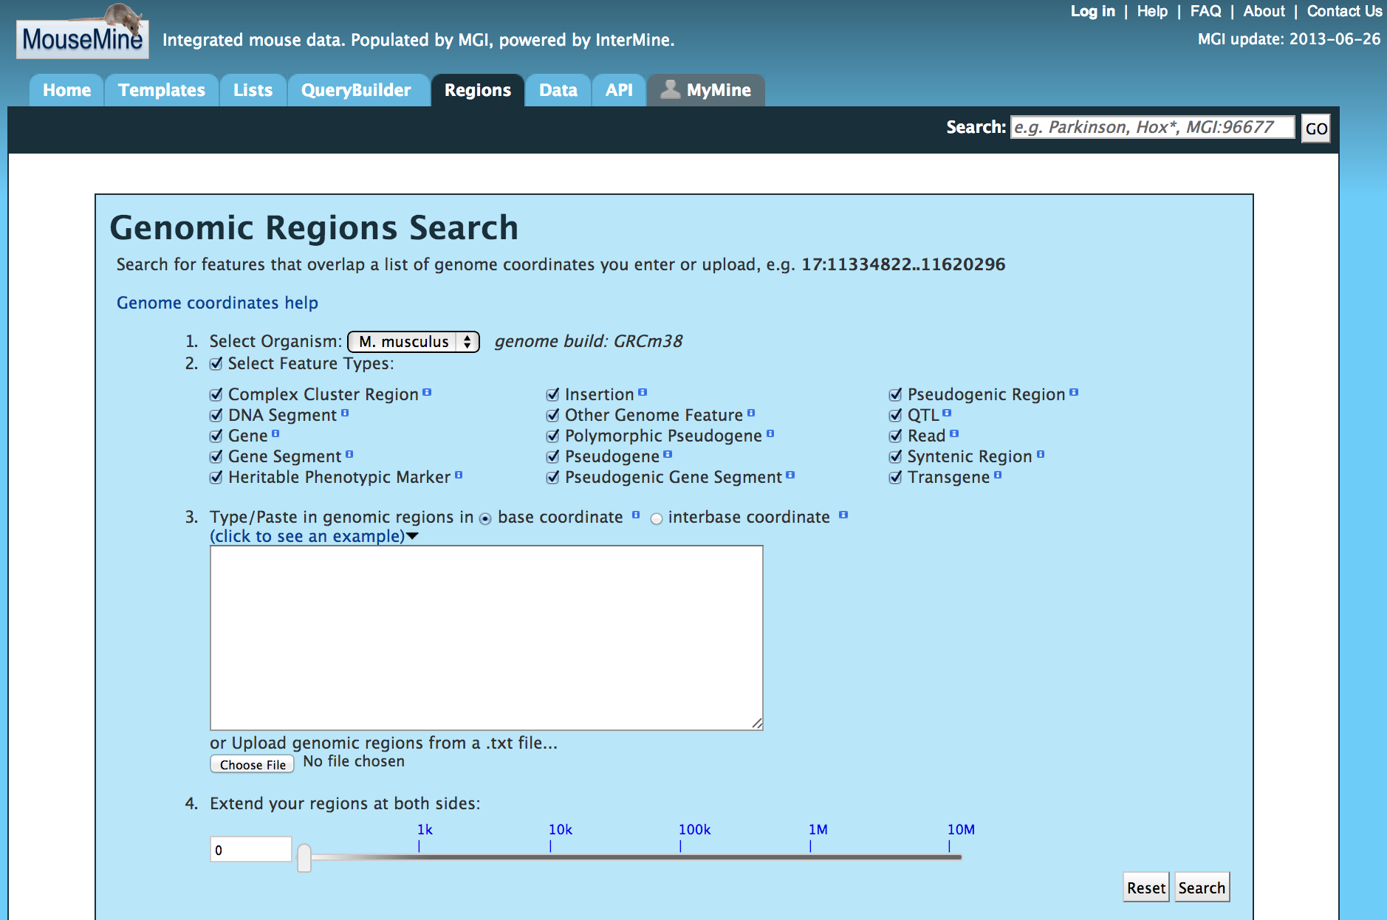
1. Click
For this example, we only want the genes.
2. Click
3. Type or paste
1:147249520-183092234
You can enter multiple regions on the same or different chromosomes!
4. Click

Slide 17
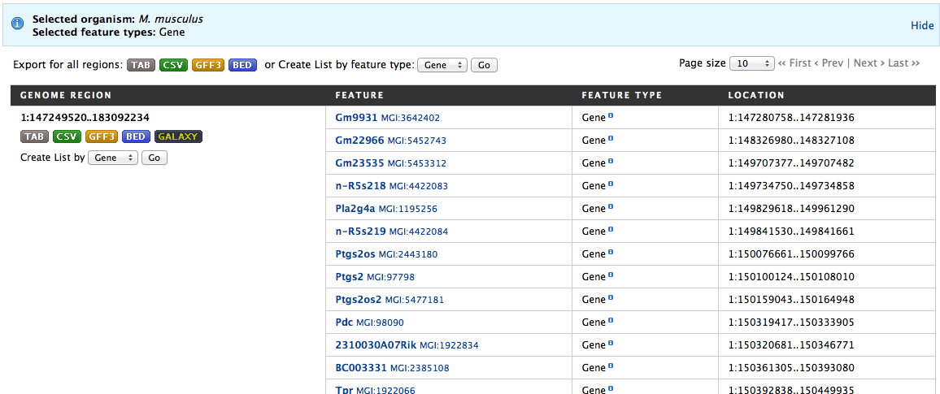
2. Create the gene list.
1. Click
Note that you can save this list of genes in several different formats.

Slide 18
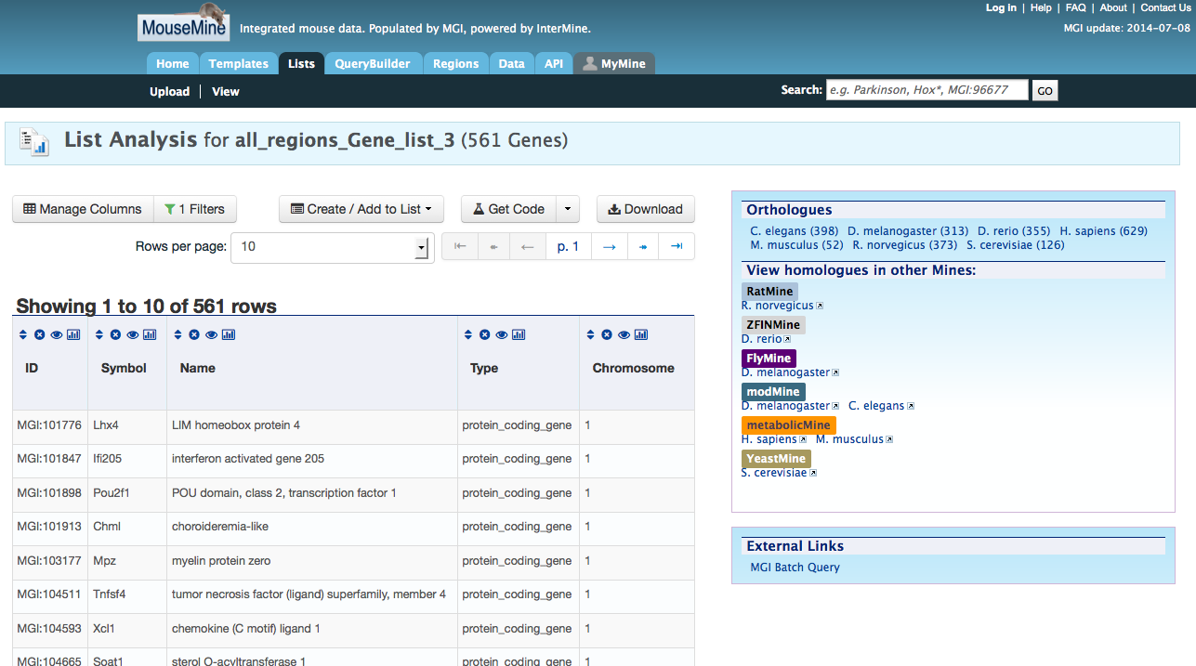
3. Explore gene annotations
1. Click
Explore the information on this page…there are quick links to orthologs in other organisms, gene list enrichment results, and summaries of gene annotations.
You can also forward this gene list to Batch Query!

Slide 19
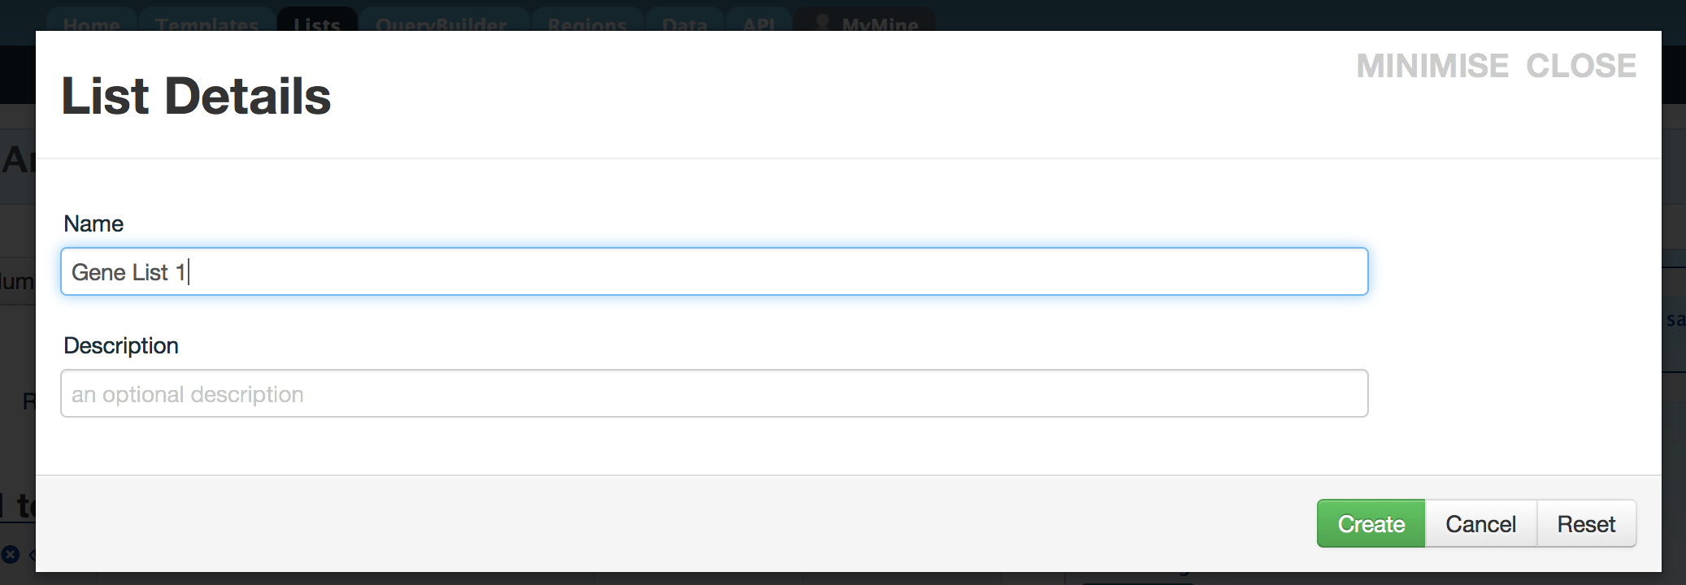
1. Click

Slide 20
4. Find the genes annotated to “lung development”.
1. Click

Slide 21
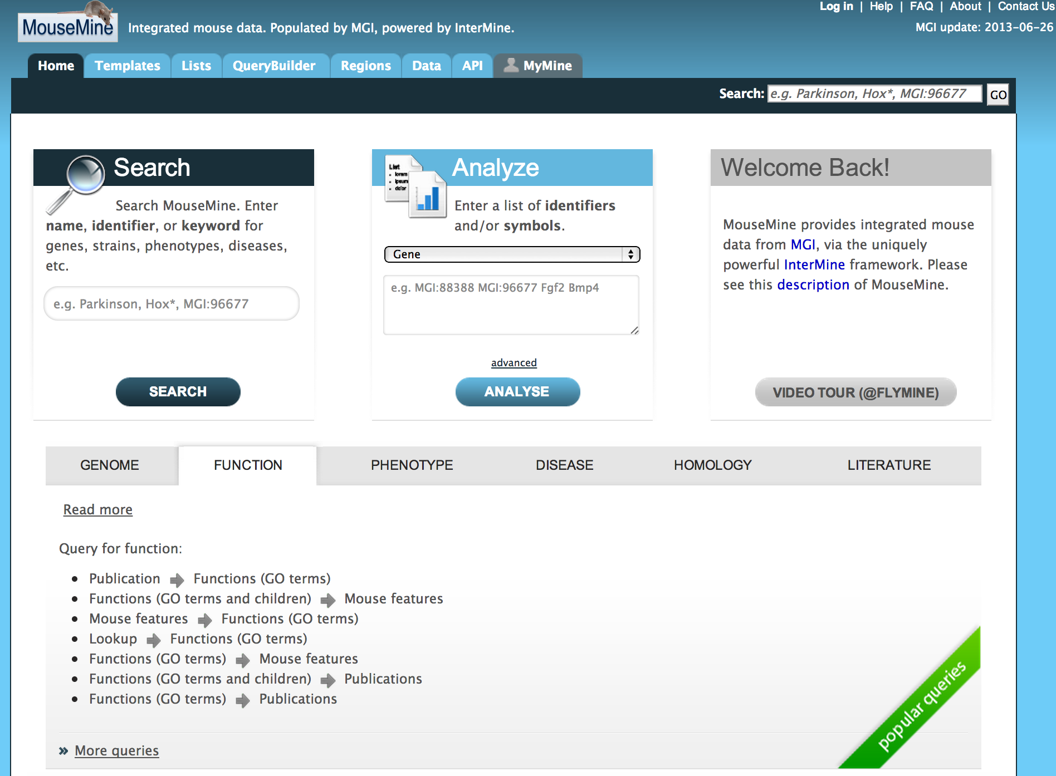
1. Click
2. Click

Slide 22
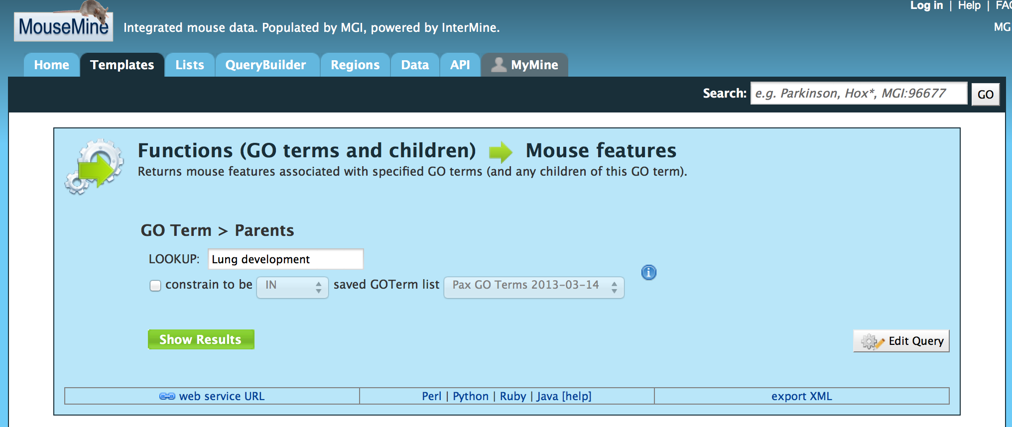
1. Type
2. Click

Slide 23
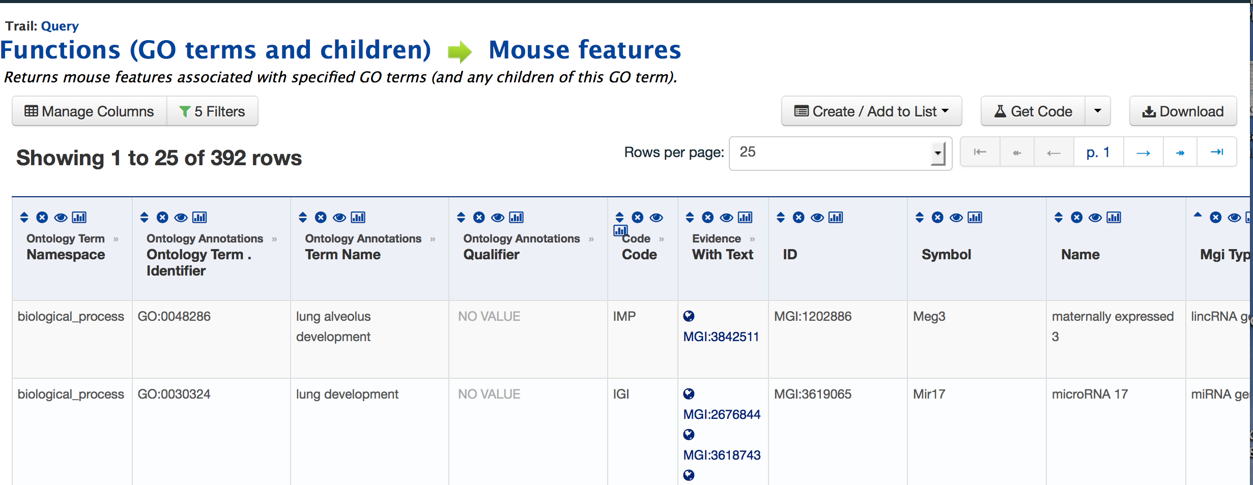
5. Save the list of lung development genes.
1. Click

Slide 24
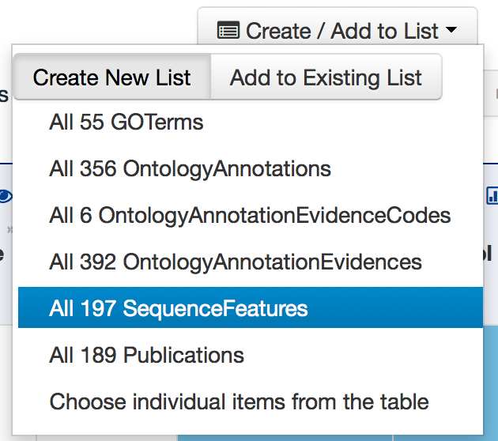
1. Click
2. Click

Slide 25
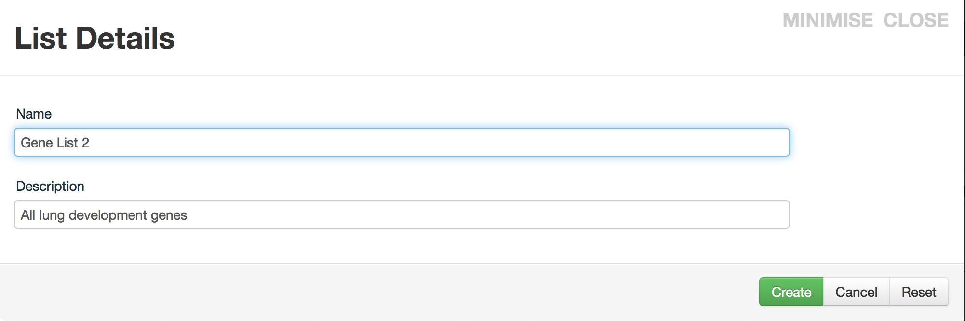
1. Type
2. Type
3. Click

Slide 26
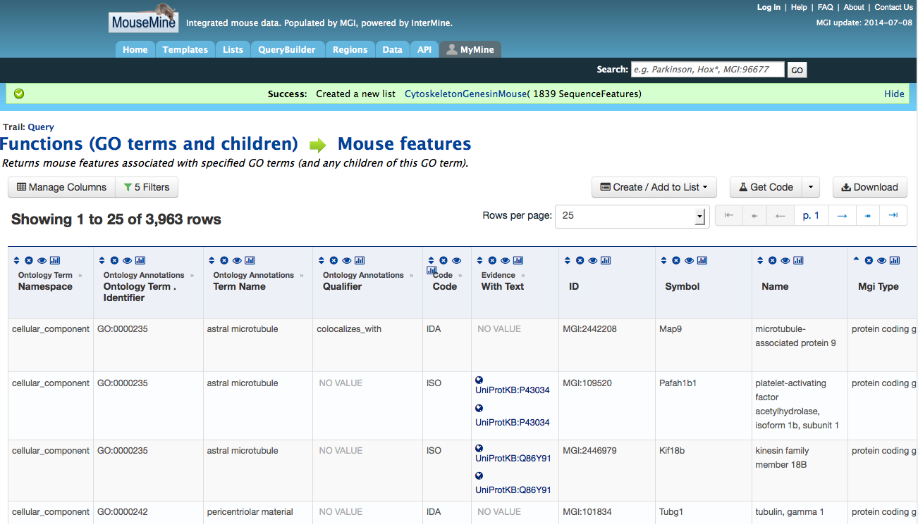
6. Intersect the gene lists
1. Click

Slide 27
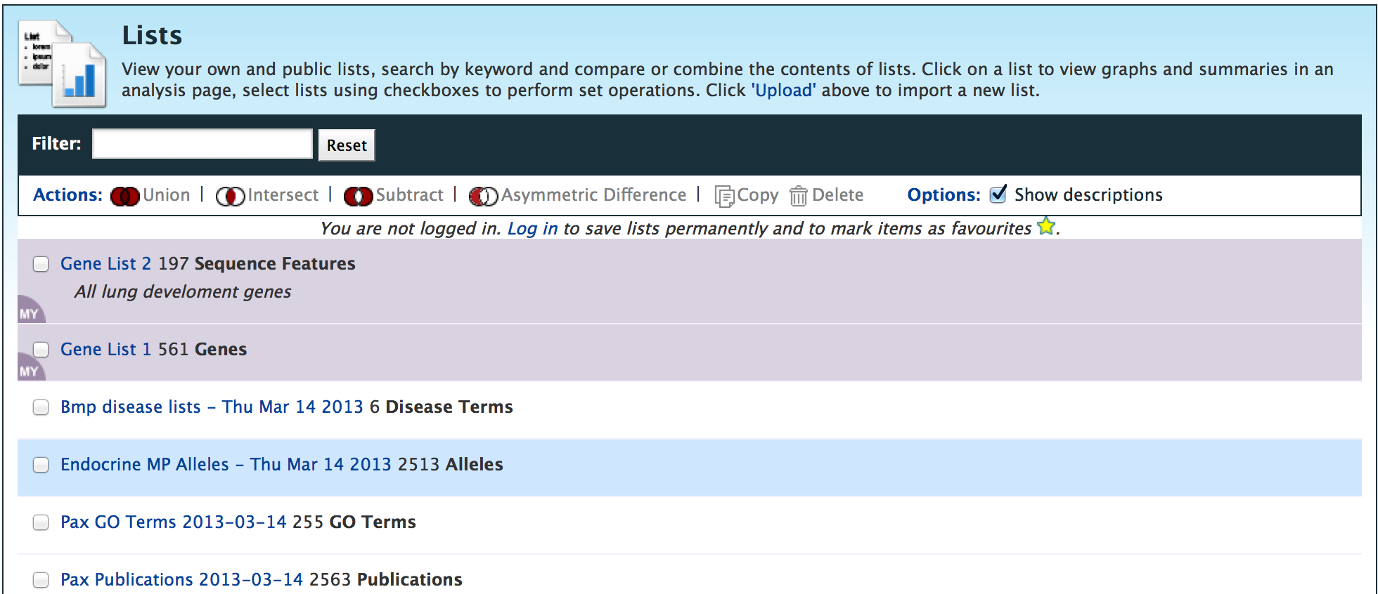
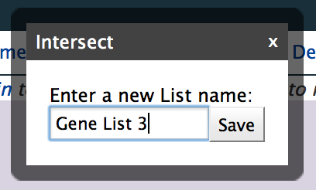
7. Save the intersected genes to a list (Gene List 3)
3. Click
1. Click
4. Type
2. Click
5. Click

Slide 28
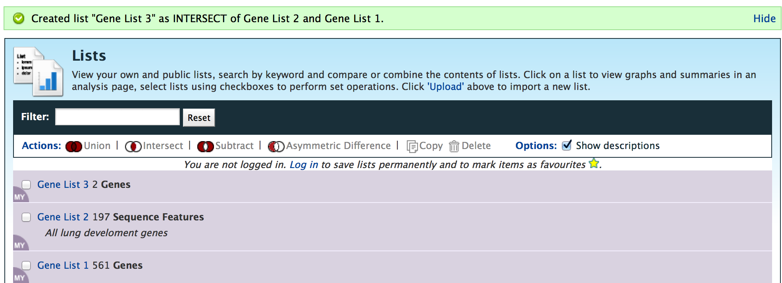
1. Click

Slide 29
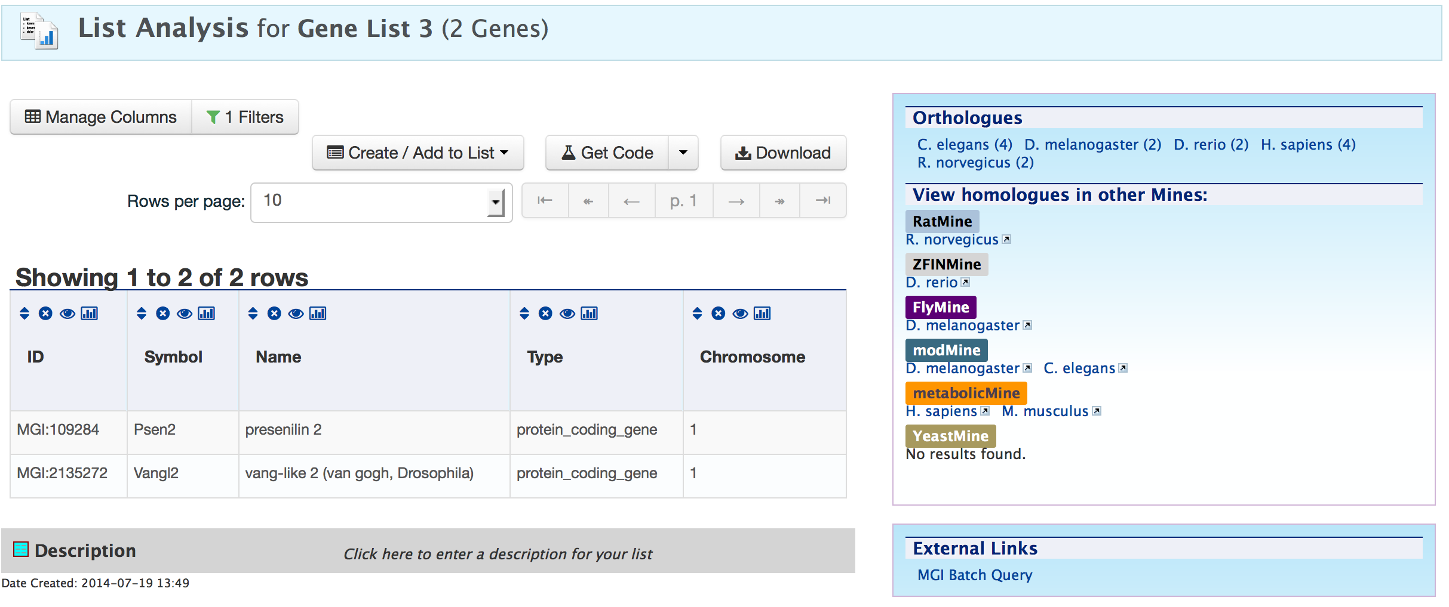
1. Click

Slide 30
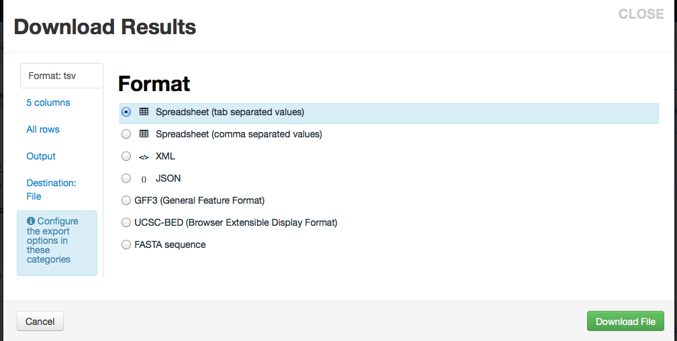
1. Click
Download results or forward results to another tool such as Galaxy or Genome Space using Destination

Slide 31
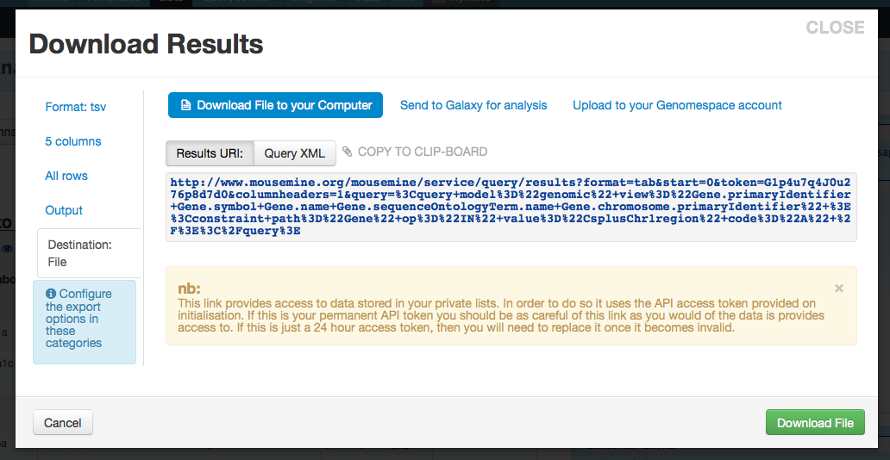

Slide 32
BONUS 1: What are all the phenotypes associated with those 561 genes in the Chromosome 1 region?
Use the template search/query tools in MouseMine

Slide 33
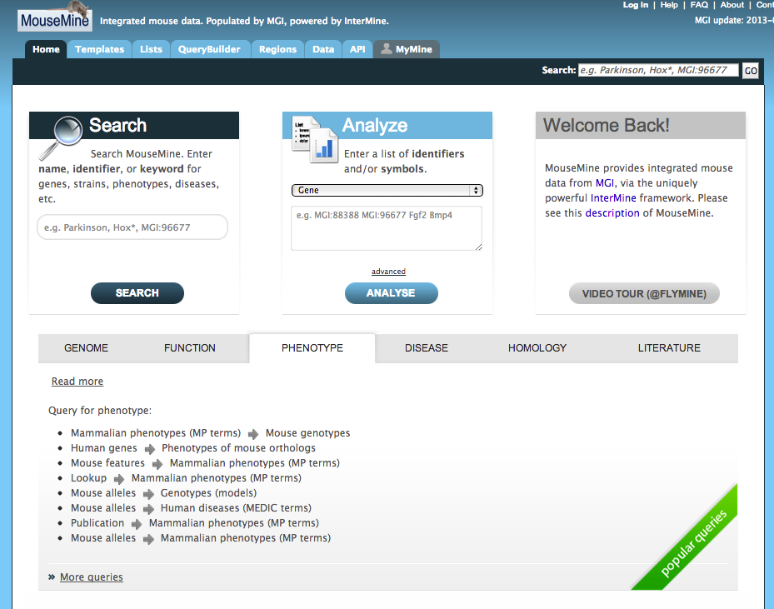
1. Click
2. Click

Slide 34
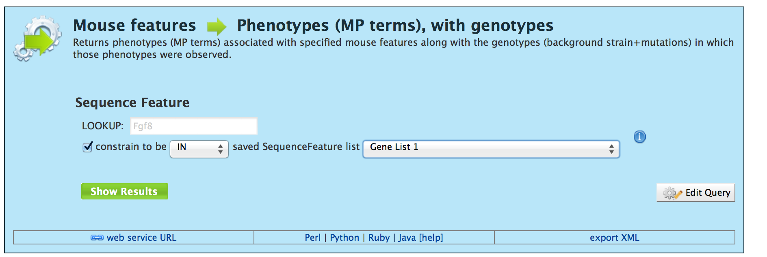
1. Click
2. Select
3. Click

Slide 35
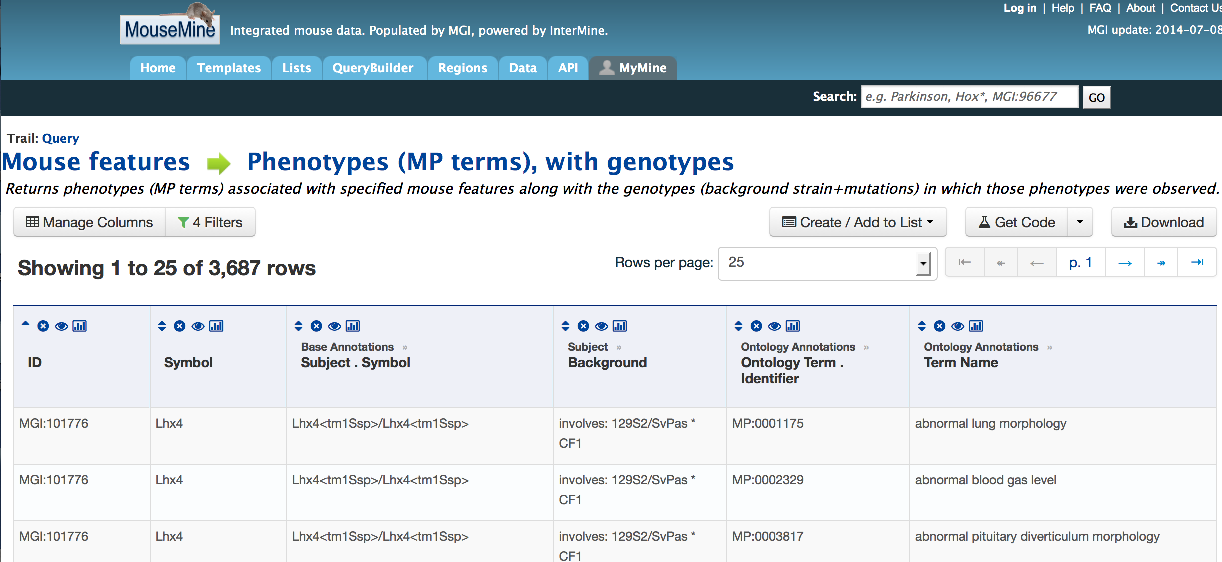

Slide 36
BONUS 2: What if you wanted to add genes associated with lung phenotypes to your list of lung development genes?
Search for genes associated with lung phenotypes in mouse.
Add those genes to Gene List 2 (the lung development genes).
Re-run the list intersection function.

Slide 37
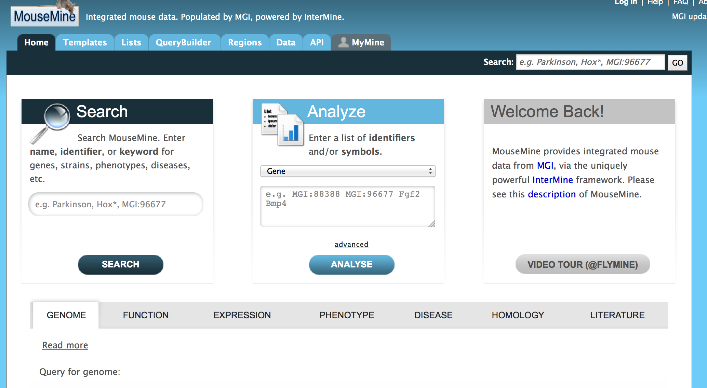
1. Click

Slide 38
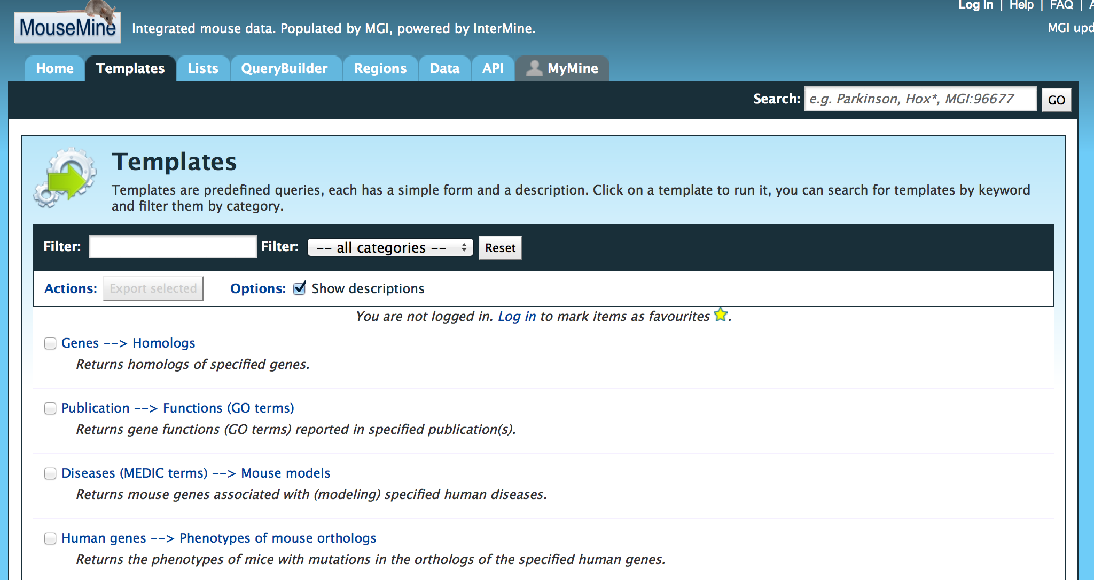
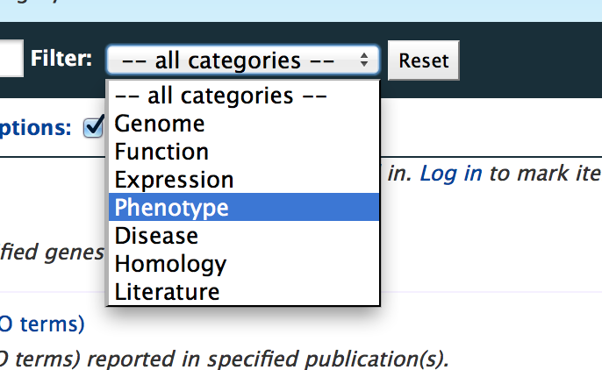
1. Click
2. Click

Slide 39
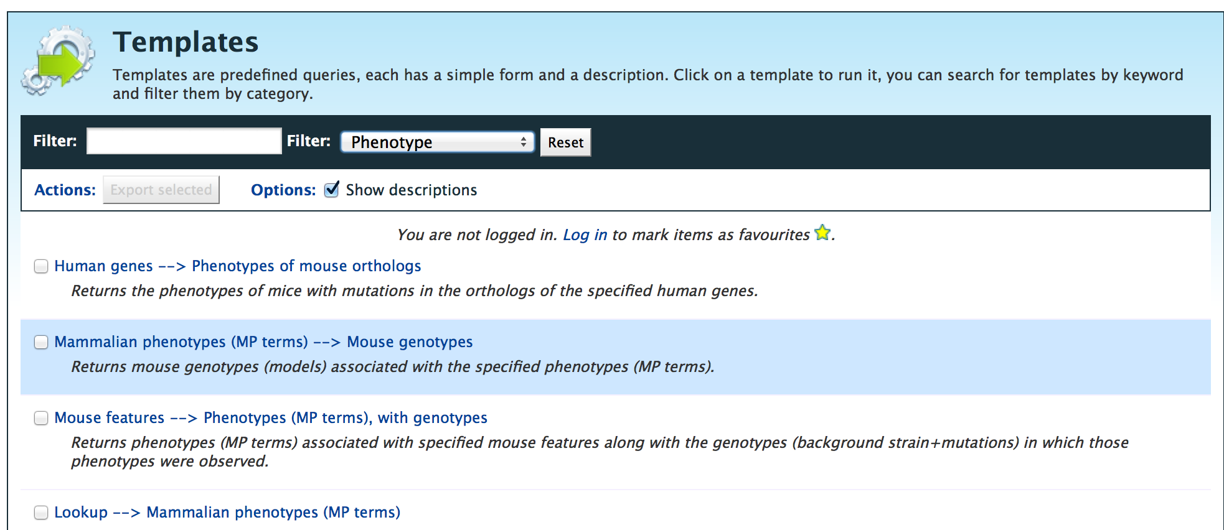
1. Click

Slide 40
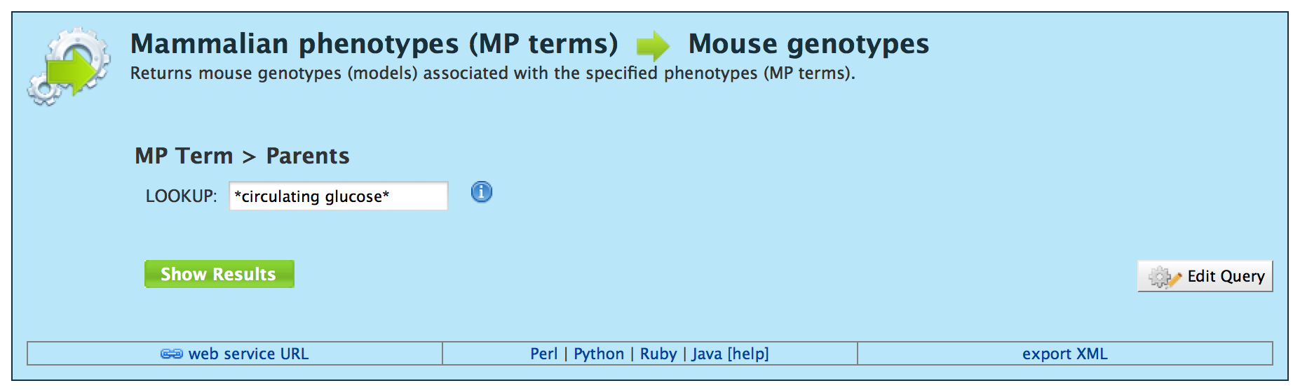
Not sure what term to type in? See next two slides!

Slide 41
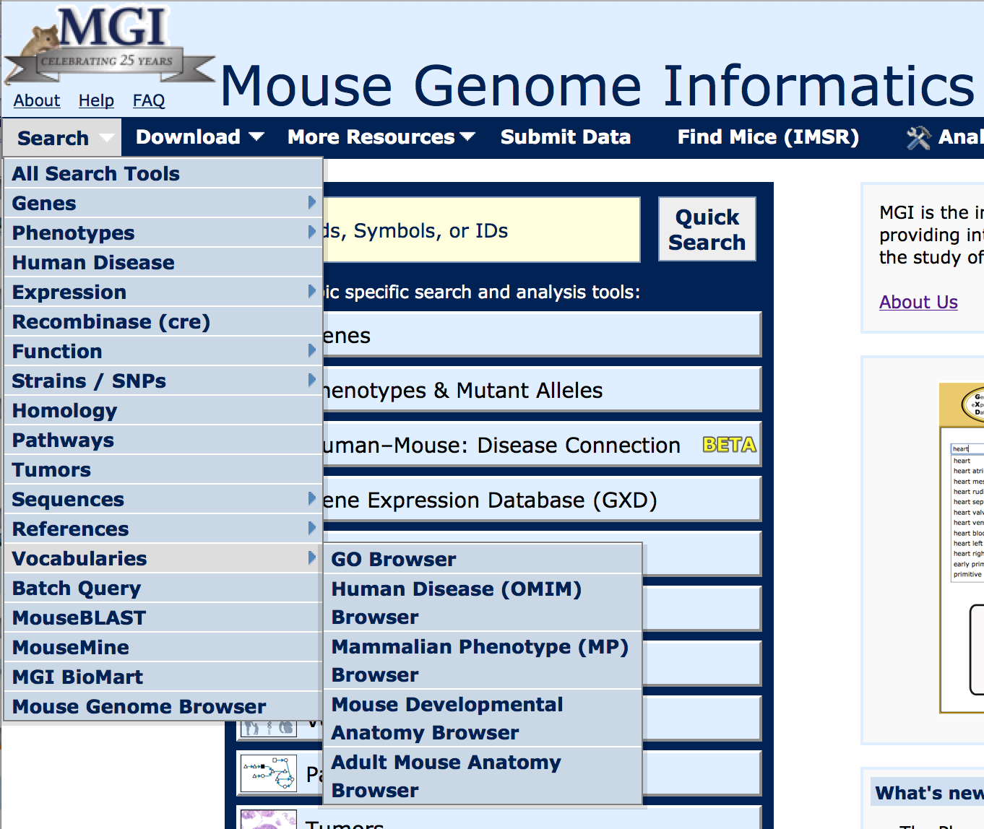
1. Click
MGI uses standard vocabularies for annotating gene function, phenotypes, etc.
Use the vocabulary browsers at MGI to get ideas for what terms to use in the MouseMine searches.
www.informatics.jax.org
2. Click
3. Click

Slide 42
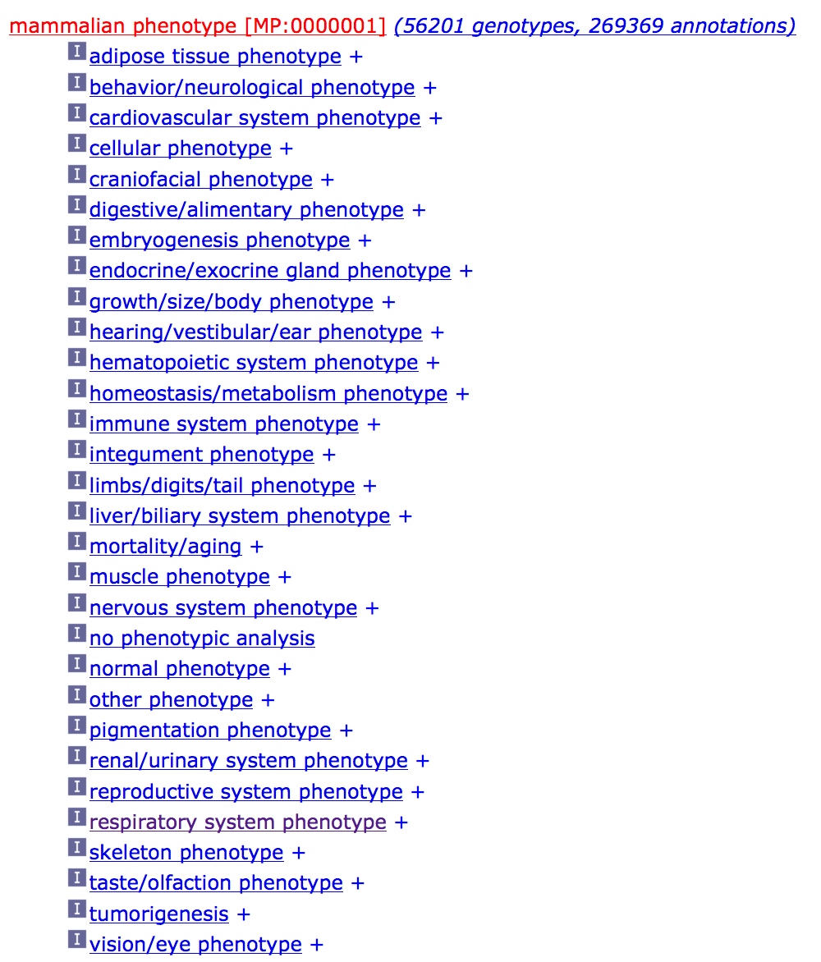
These are the high level Mammalian Phenotype (MP) terms used to annotated mouse phenotypes in MGI.

Slide 43
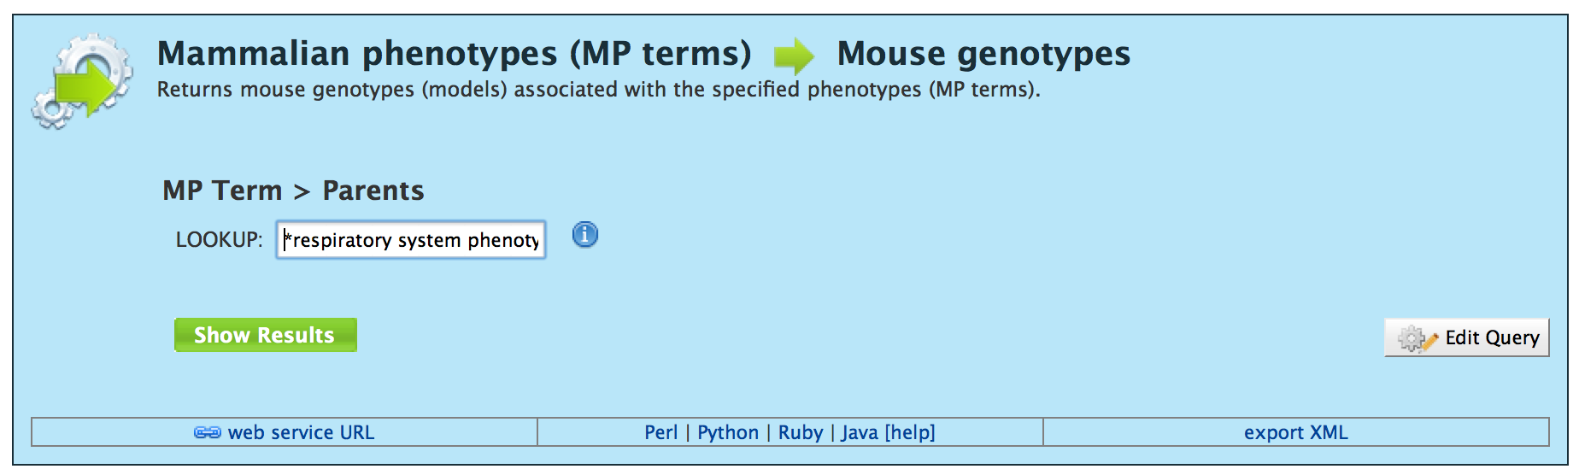
1. Type
*respiratory system phenotype*

Slide 44
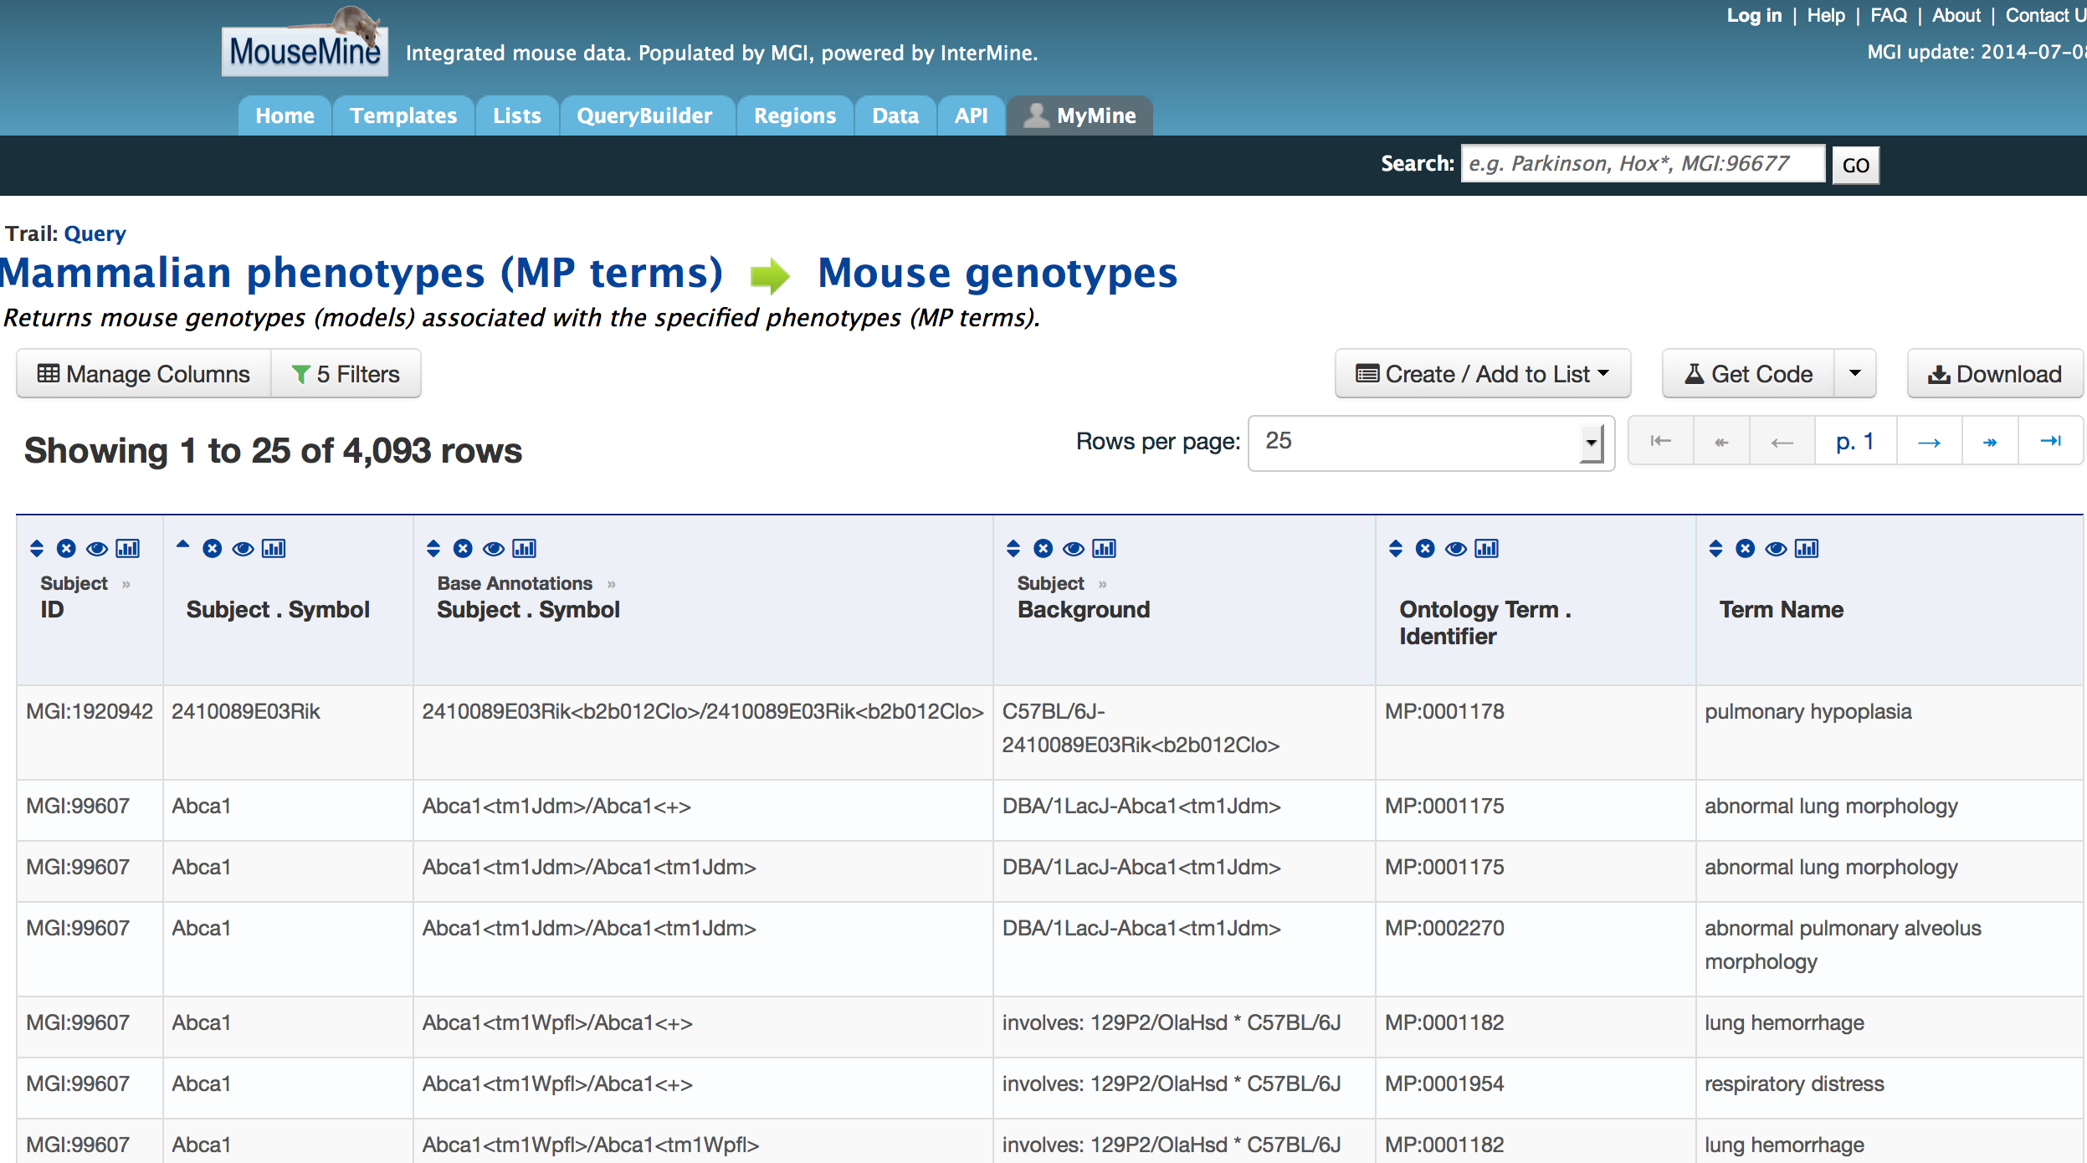
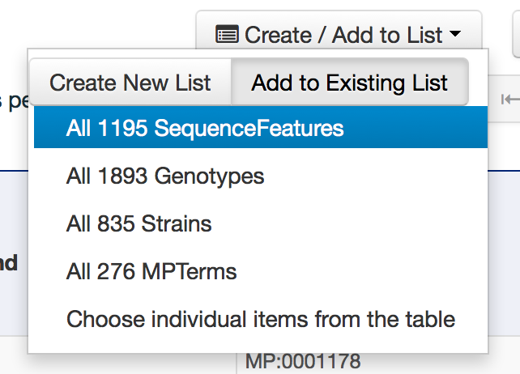
1. Click
2. Click
3. Click

Slide 45
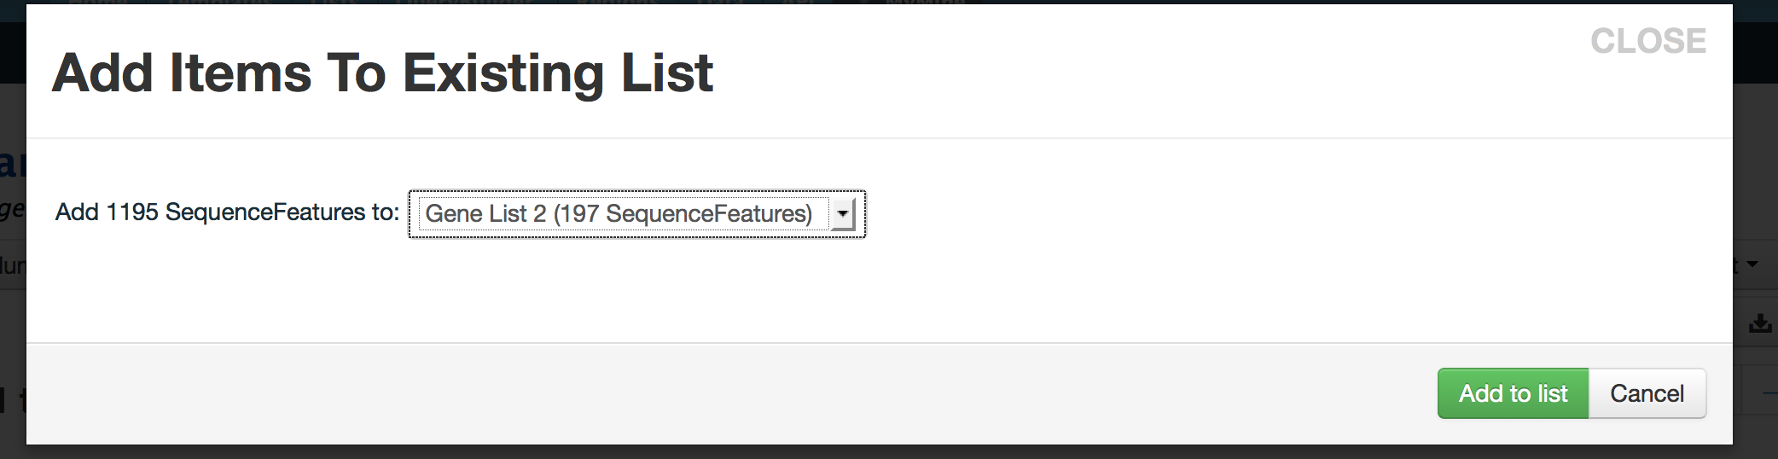
1. Click

Slide 46
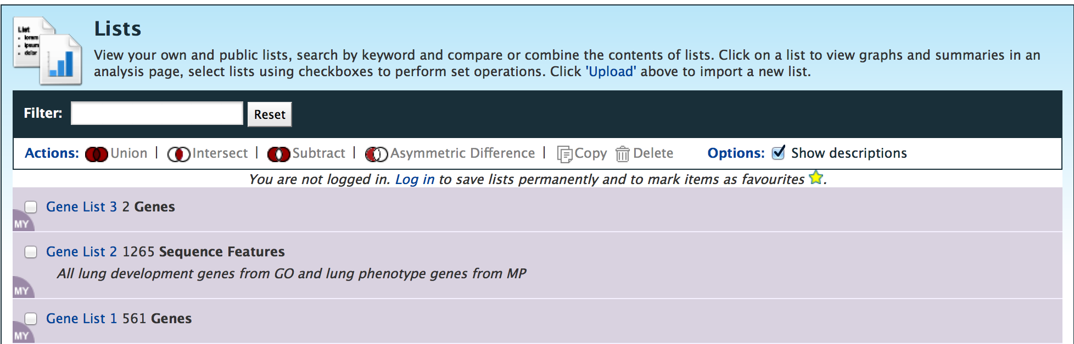
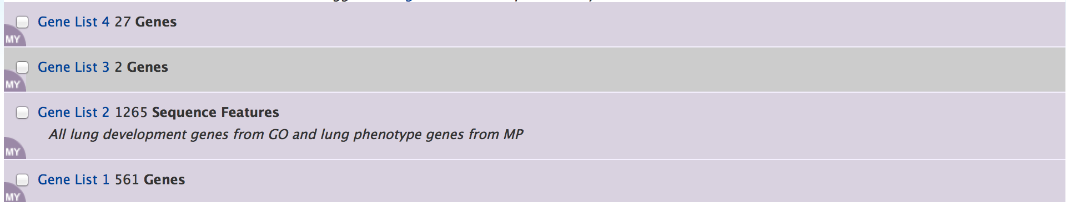
You can see that Gene List 2 has more genes in it now. Click to see the list and update the list description.
After intersecting Gene List 1 with the updated Gene List 2 you get 27 lung related genes instead of 2.

Slide 47
Your Turn!
There are many heritable phenotypes in the MGI database where the phenotype has been mapped but the causative gene is not known.
Eccp (eccentric pupil) has been mapped to chromosome 12 (Chr12:35901444-82619165; GRCm38)
Look up Eccp locus in MGI
How was this phenotype identified?
What strains were used for mapping?
Is the mouse strain available?
Use MouseMine to find genes in the mapped region that are associated with eye phenotypes
Use the list of genes you find using MouseMine as input into the SNP query form @ MGI to see if there are any SNPs in these genes between the strains used to map the phenotype
MGI: www.informatics.jax.org
MouseMine: www.mousemine.org

